Slide 1

趣说精英
Qu Shuo Jing Ying
Group Members： 胡碧皓 潘香霖 武美玖 刘冠群 韩庆慧

Slide 2
01
Introduction
02
Customer needs & External search
03
KIEBIE & Learning theory
目 录
CONTENTS
04
Technology & LA
05
UX evaluation
06
Final design & Conclusion

Slide 3
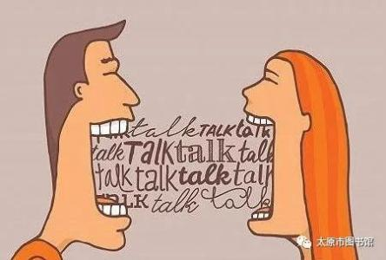


Introduction
01
02
03
Necessity
Requirement
Significance
Spoken English is necessary for everyone who learn English.
Most of them want to learn English anywhere anytime.
Ubiquitous spoken English learning platform is needed for solving this problem.
Mobile
Ubiquitous
Spoken English

Slide 4
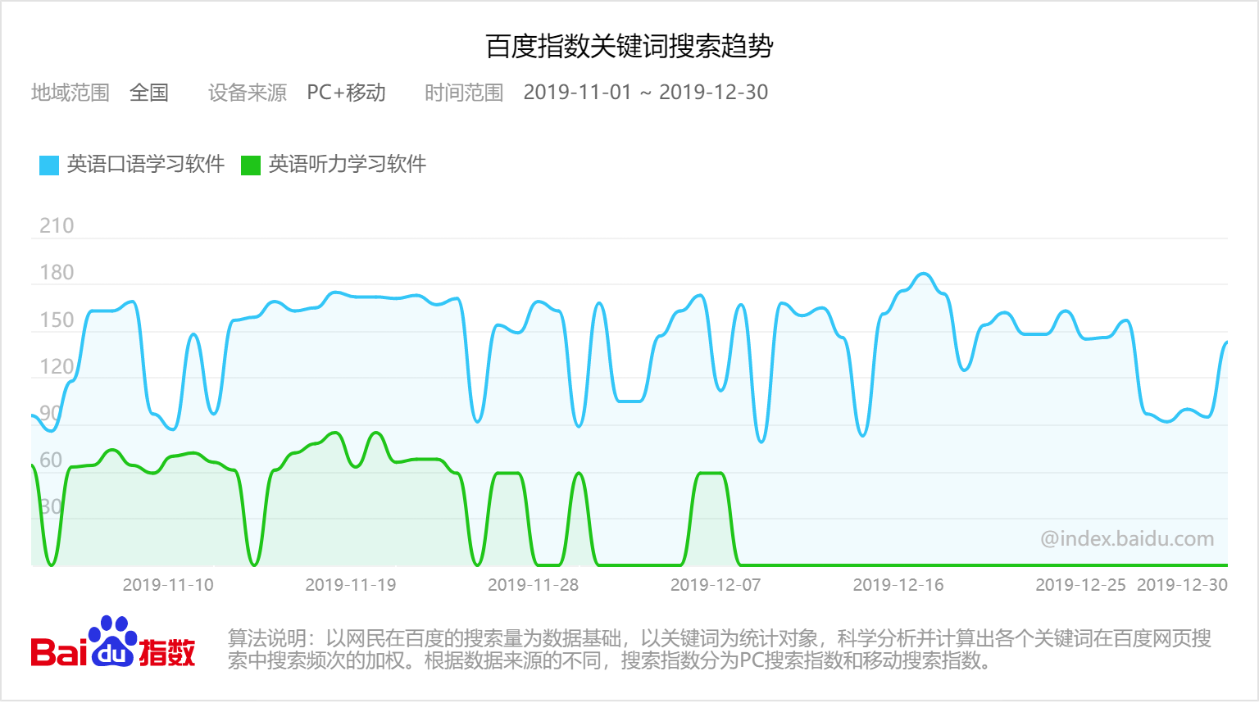
Customer Needs Assessments
From: Baidu Index Search Results
Searching of English speaking software is higher than English listening software.

Slide 5
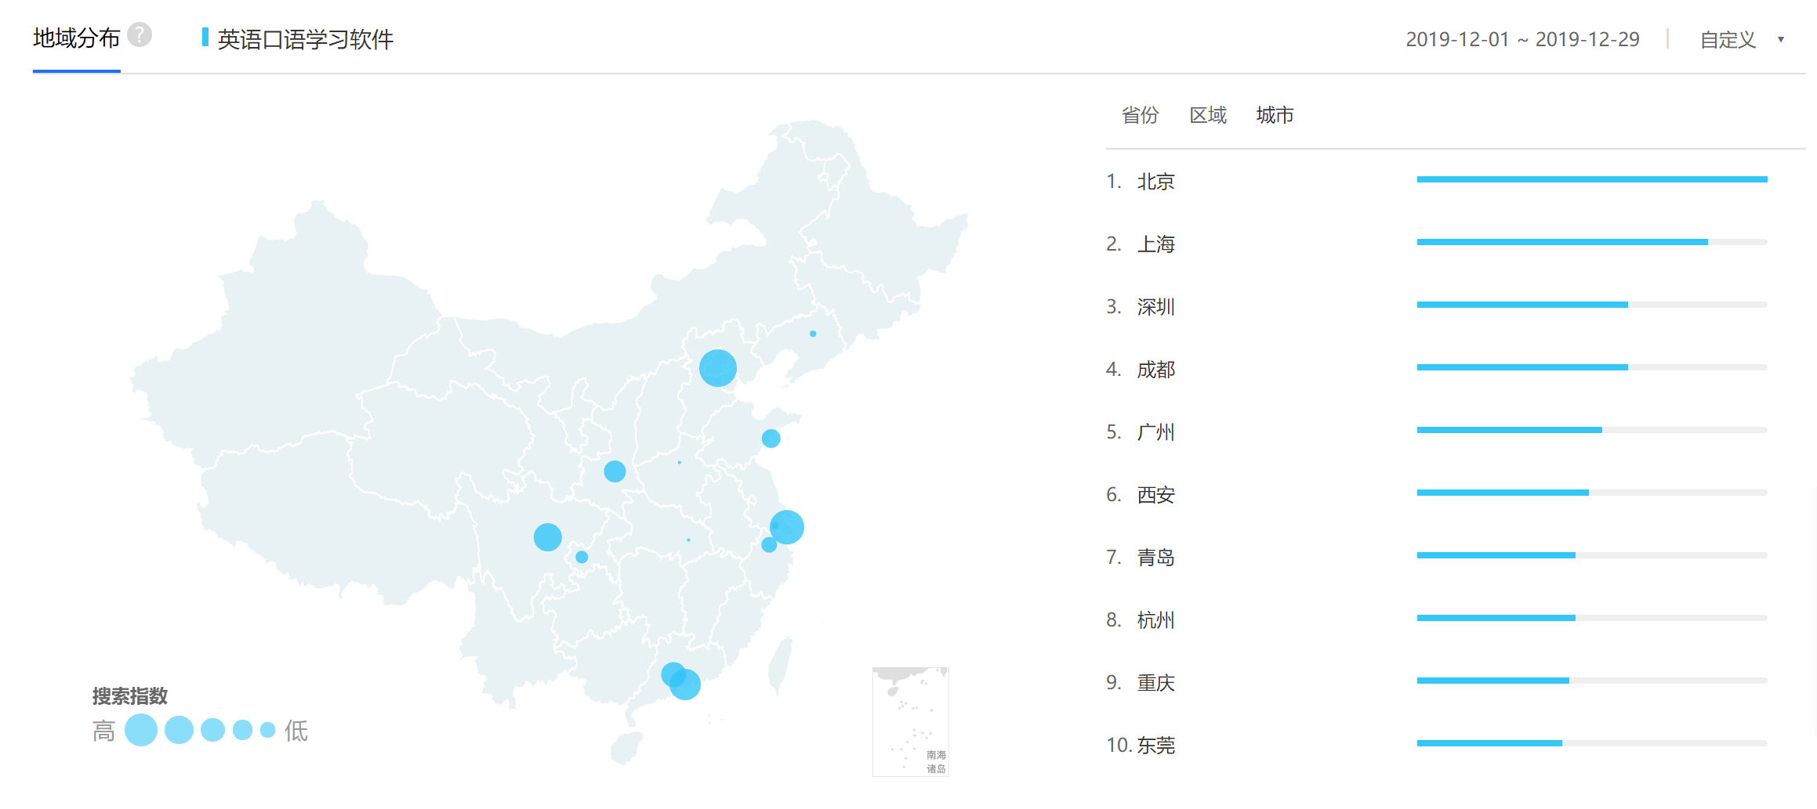
Customer Needs Assessments
From: Baidu Index Search Results
Most of the users are from Beijing, Shanghai and Shenzhen.

Slide 6

Interview of Customer Needs
4
3
1
Weighting
3
2

Slide 7
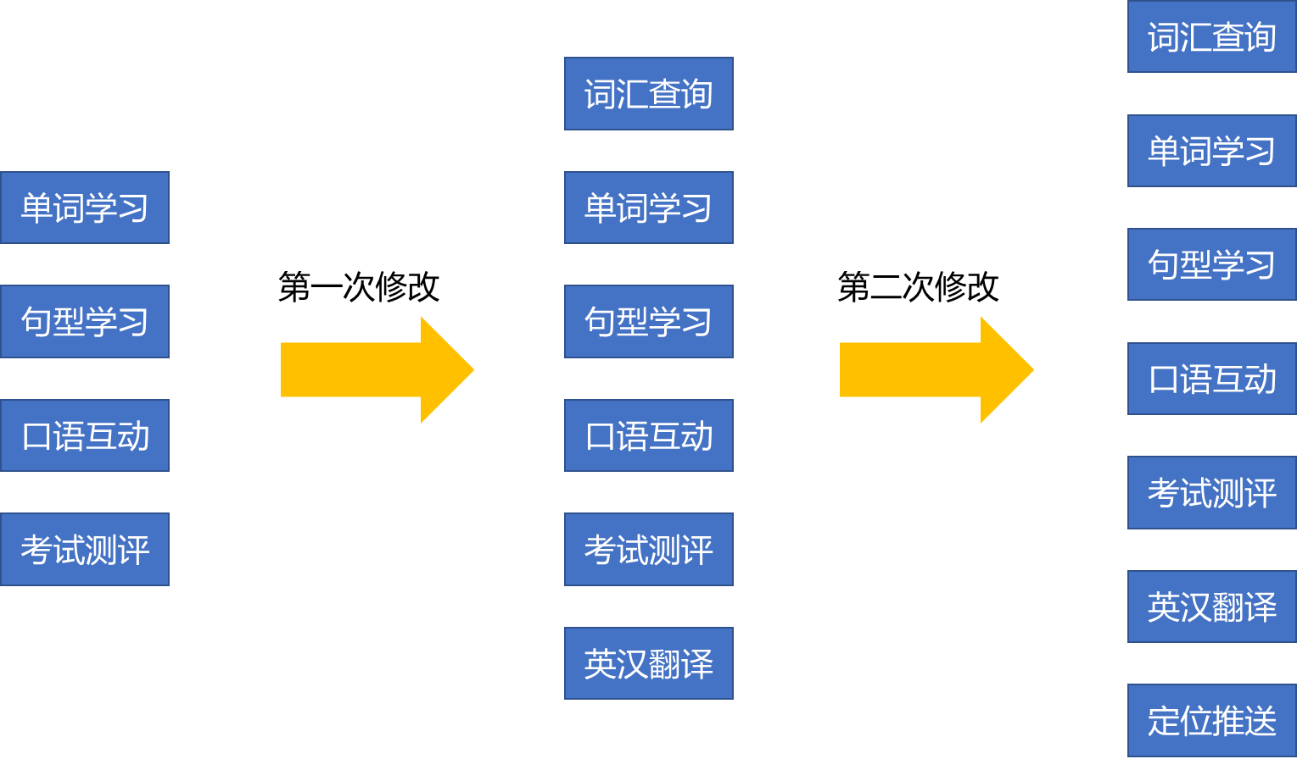
Revised Needs & Target Specification

Slide 8
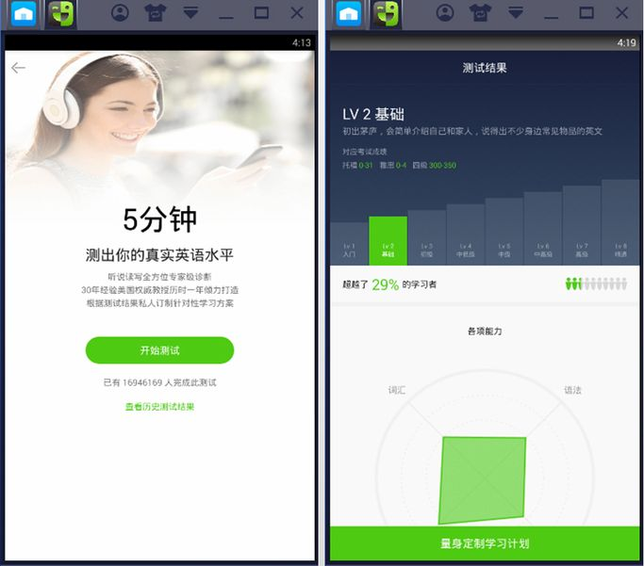
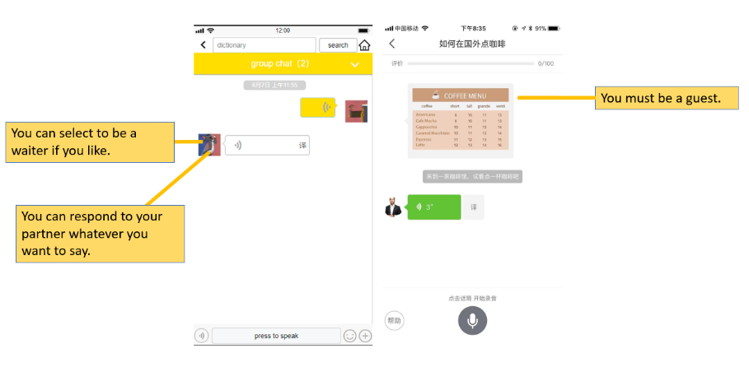
External Search (Liulishuo)
Proficiency test
Personalized learning
Real person-matched dialogue
Drawbacks
it is not allowed to choose a character.
Users are not free to create and speak.

Slide 9
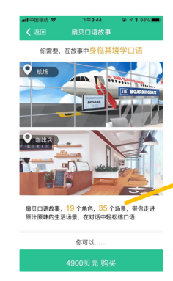
External Search (Shanbay)
Drawbacks
No real person-matched dialogue.
Users have to pay for the story scene.
Story scene

Slide 10
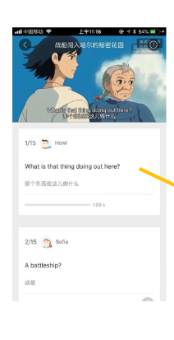
External Search (Fun dubbing)
Drawbacks
Not involving the simulation of real scenes.
Users have to pay for the recording score.
Can’t collect the favorite sentence.
imitation for video dubbing

Slide 11
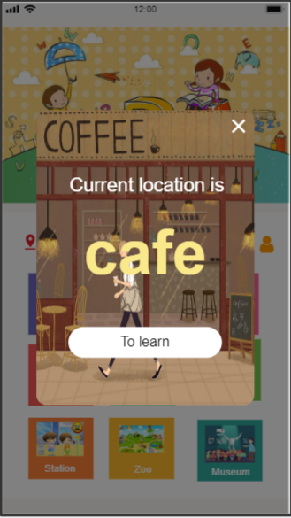
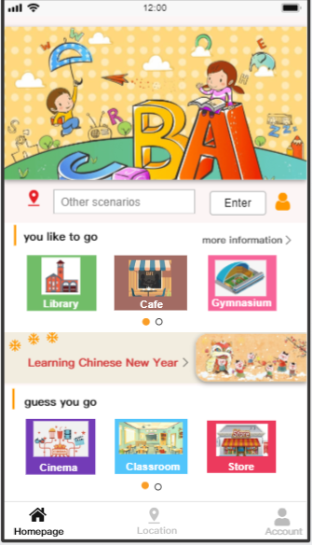
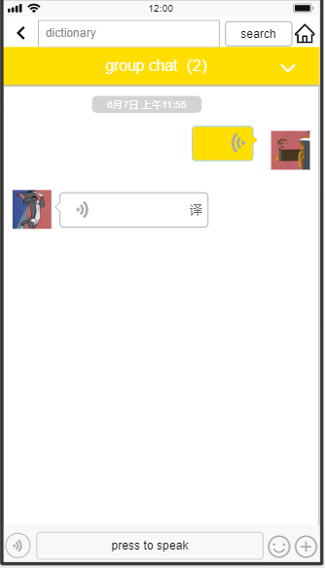
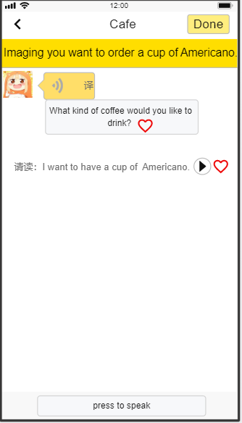
External Search (QuShuoJingYing)
Location identification
Personalized Learning
Be free to talk with real people
Add the sentence as a favorite one

Slide 12
KIEBIE Analysis
03
Behavior
06
Experience
Listening, speaking, sending message, pressing to speak, uploading, sliding left and right
Pronounce accurately，speak quickly and fluently and confidently
02
Knowledge& Skill
Vocabulary, intonation, pronunciation, dialogue
Speaking skill. Communication skill…
04
Interaction
Human-human interaction
Human-machine interaction
05
Interact object
01
Environment
Real people, virtual partner
Smart phone application

Slide 13
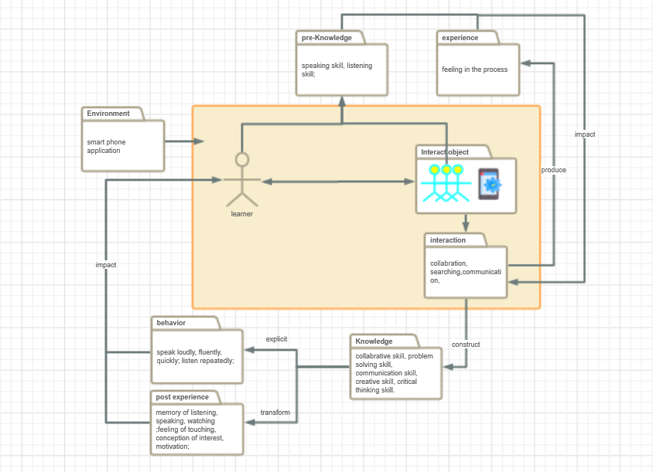
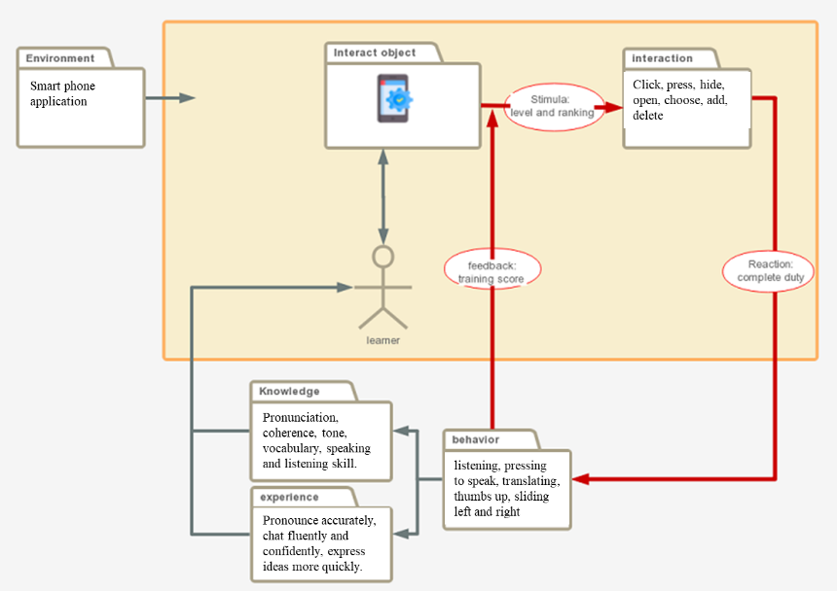
Learning Theory
Constructivism theory
Behavorism theory

Slide 14
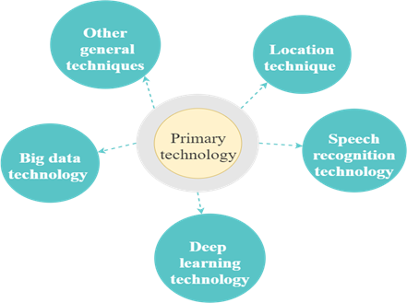
Technology Applying
automatically provide corresponding scenes
communication technology, algorithms
recognize user’s pronunciation and give feedback
Capture and analyze user’s learning behaviors and path
automatically predict and recommend the possible learning scenarios

Slide 15
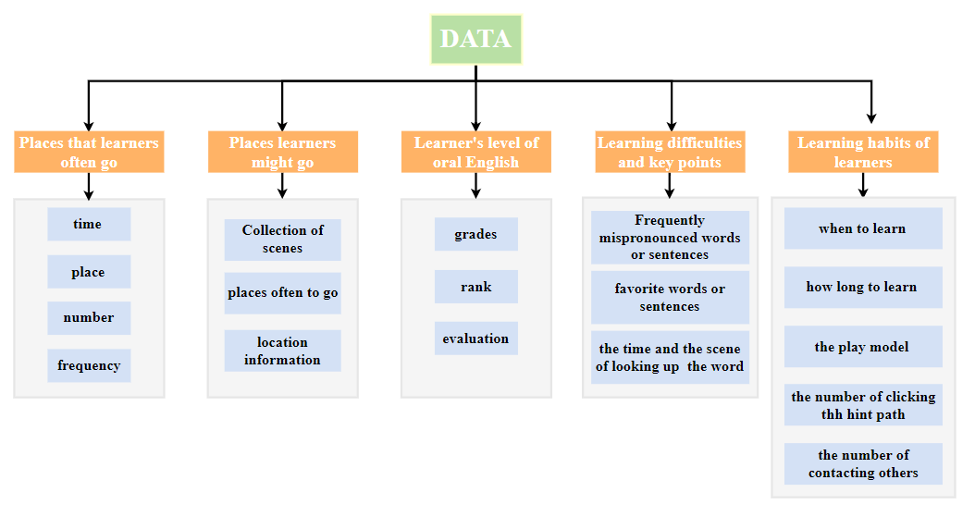
Data We Need

Slide 16
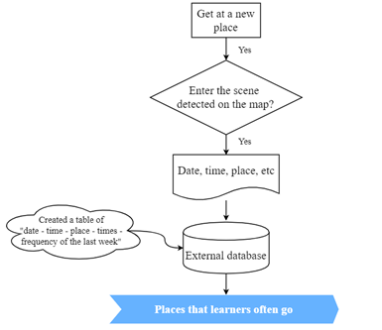
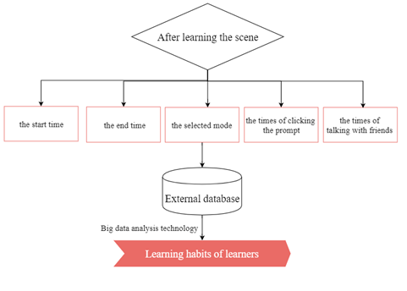
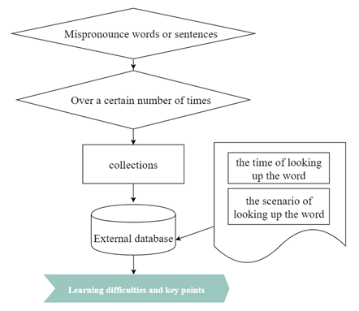
How to Capture Data

Slide 17
How to Structure Data
learning difficulties and key points | xAPI
mispronounced word or sentence usually | Actor | Verb | Object | Results (times)
 | Haohao | mispronounced | word | 4
the scene of query word or sentence | Actor | Verb | Object | Context
 | Haohao | query | words | coffee
eg,. The xAPI of learning habits of learners

Slide 18
UX Analysis—Sample Size and Inconsistency
Only 5 invalid answers in 4 demensions.
Most of the participants were very serious about this questionnaire.
Our sample size is 30, the precision is 0.5.
results

Slide 19
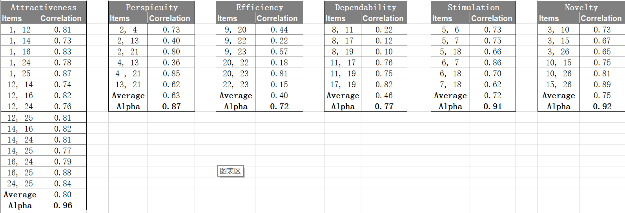
UX Analysis—Scale Credibility
The whole scale had a certain credibility.
Efficiency and dependability were not lose its value.
results

Slide 20
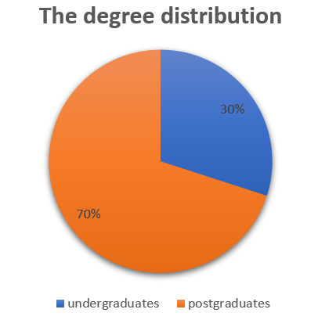
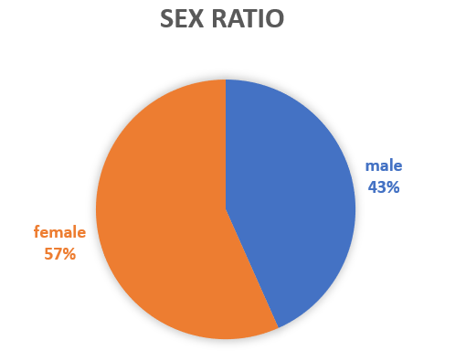
UX Analysis—Sample Description
Undergraduate students 70%, graduate students 30%.
57% female and 43% male.
results

Slide 21
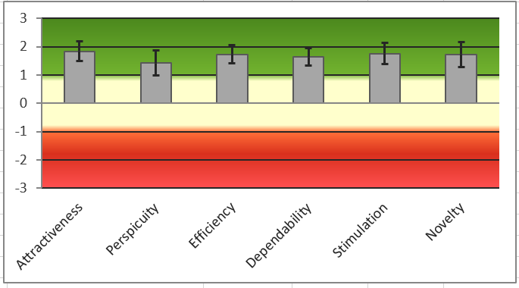
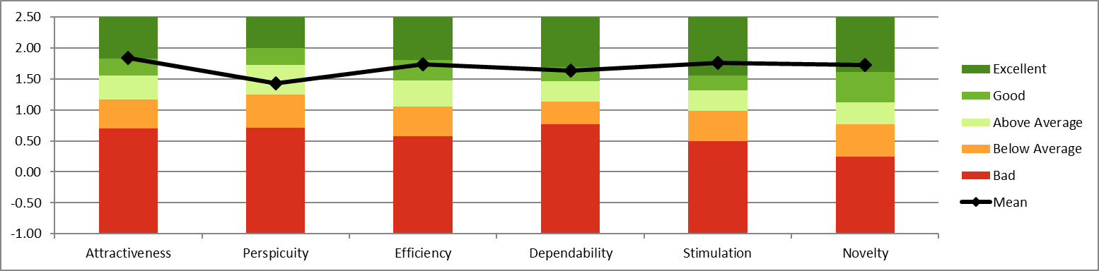
UX Analysis--Results
The mean value of six scales are higher than 1.4.
Perspicuity dimension need to be improved.
results

Slide 22
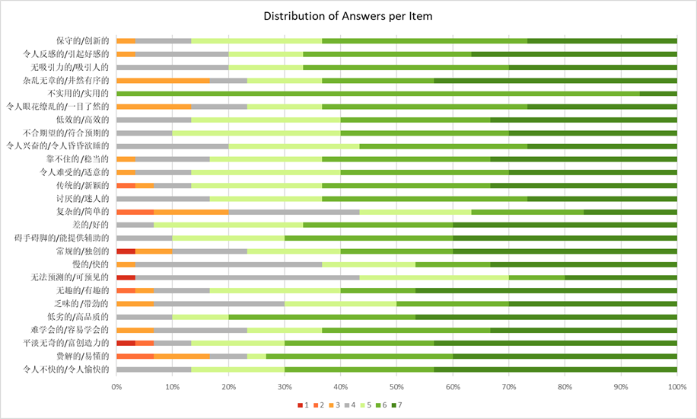
UX Analysis—Scale Credibility
Most of the users think highly of our platform.
Few of them gave us some suggestions to improve.
results

Slide 23
Conclusion
The design tool was just free for 15 days.
We all actively involved with a high efficiency.
01
Glow
02
Grow
We need to improve the function of setting speed and different types of accent.
Suggestions of other groups and teacher helped us a lot.
03
Glow
04
Grow

Slide 24
Self Assessment
01
02
03
04
05
潘香霖 20%
韩庆慧 20%
刘冠群 20%
胡碧皓 20%
武美玖 20%
Self assessment
Learned a lot；
Interest of designing
Critical thinking；
Contribution of reports：
KIEBIE analysis ；
learning theory；
UX survey and analysis
Self assessment
actively participate in；
effectively complete
Contribution of reports：
technology applying；
learning analysis；
Conclusion
UX survey and analysis
Self assessment
Carefully participated in；
Carefully recorded；
Contribution of reports：
Customer Needs Assessment；
Revised Needs Statement；
UX survey and analysis
Self assessment
Actively participated in；
Helped each other；
Enjoyed the collaboration
Contribution of reports：
Final design intro；
UX survey and analysis
Self assessment
actively participated；
accepted the suggestions；
benefited a lot；
Contribution of reports：
introduction ；
external search；
UX survey and analysis

Slide 25
THANKS FOR LISTENING!

